Slide 1


Yassin Abda
30/04/2023

Slide 2

Outline
Executive Summary
Introduction
Methodology
Results
Conclusion
Appendix

Slide 3
Executive Summary
Summary of methodologies
Data collection
Data Wrangling
EDA with data visualization
EDA with SQL
Building an interactive map with Folium
Building a dashboard with Plotly Dash
Predictive analysis (Classification)
Summary of all results
EDA results
Interactive analytics
Predictive analysis

Slide 4
Introduction
Project background and context
SpaceX can reuse the first stage of the Falcon 9 rockets; which in turn, saves a considerable amount of money leading it to be much cheaper than its competitors. With a cost of 62 million dollars per Falcon 9 rocket compared to a cost of upwards to 165 million dollars for its competitors.
Problems you want to find answers
Predicting if the first stage of the Falcon 9 rockets will land successfully or not.

Slide 5

Section 1

Slide 6
Methodology
Executive Summary
Data collection methodology:
SpaceX Rest API
Web Scrapping from Wikipedia
Perform data wrangling
One hot Encoding data fields for Machine Learning and data cleaning of null values and irrelevant columns
Perform exploratory data analysis (EDA) using visualization and SQL
Perform interactive visual analytics using Folium and Plotly Dash
Perform predictive analysis using classification models
LR, KNN, SVM, DT models have been built and evaluated for the best classifier

Slide 7
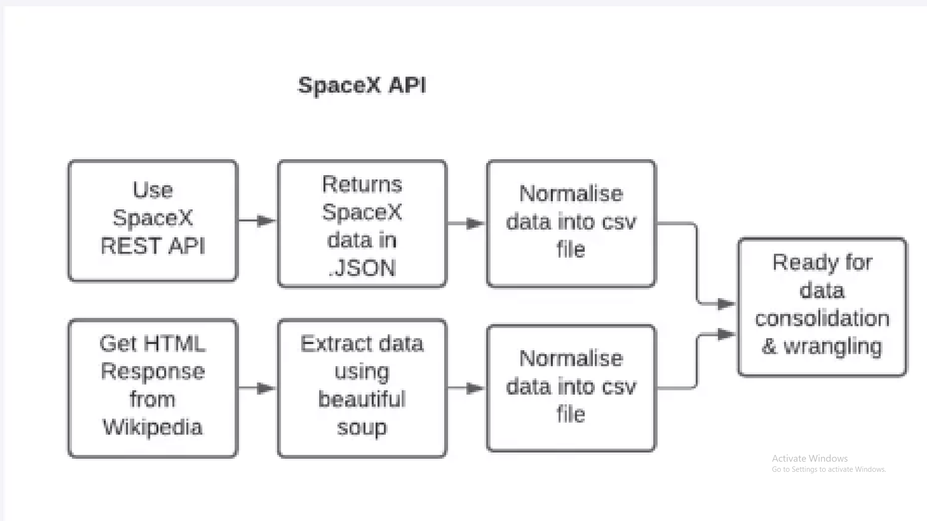
Data Collection
The following datasets were collected:
SpaceX launch data that is gathered from the SpaceX REST API.
This API will give us data about launches, including information about the rocket used, payload delivered, launch specification and landing outcome.
The SpaceX REST API endpoints, or URL, starts with api.spacexdata.com/v4/.
Another popular data source for obtaining Falcon 9 launch data is web scrapping from Wikipedia using BeautifulSoup.

Slide 8
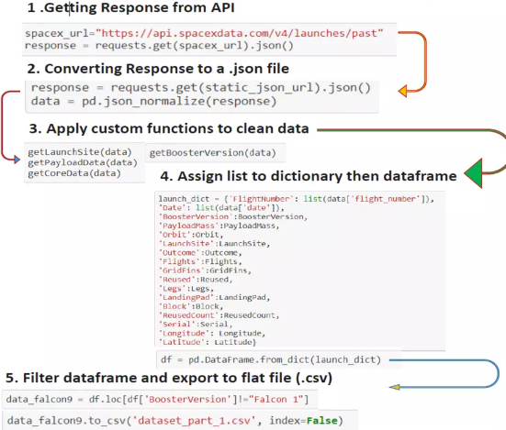
Data Collection – SpaceX API
Data collection with SpaceX REST calls
https://github.com/yassin-asu/data-science-capstone-/blob/26caaf9ac9ad8d141cc6c34d3e4085601bce6101/data%20wrangling.ipynb
Place your flowchart of SpaceX API calls here

Slide 9
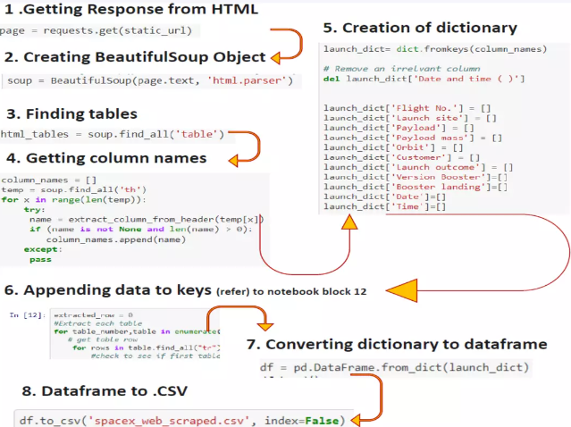
Data Collection - Scraping
Web Scrapping from Wikipedia
https://github.com/yassin-asu/data-science-capstone-/blob/26caaf9ac9ad8d141cc6c34d3e4085601bce6101/data%20collection%20with%20web%20scraping.ipynb
Place your flowchart of web scraping here

Slide 10
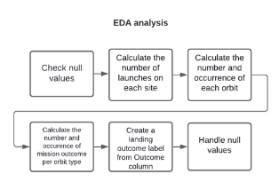
Data Wrangling
EDA analysis
https://github.com/yassin-asu/data-science-capstone-/blob/26caaf9ac9ad8d141cc6c34d3e4085601bce6101/eda.ipynb

Slide 11
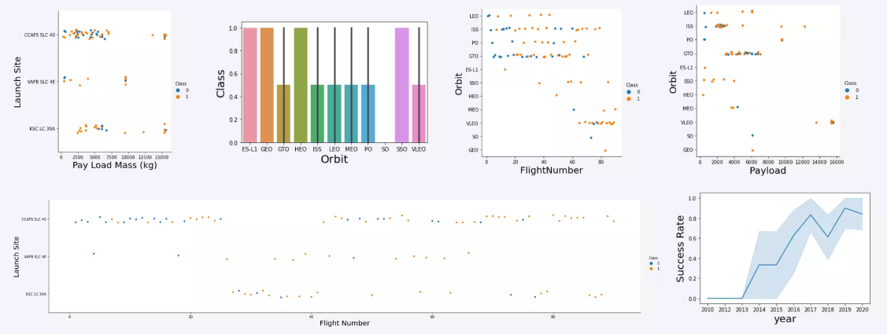
EDA with Data Visualization
Visualizing the data to further simplify and understand.
https://github.com/yassin-asu/data-science-capstone-/blob/26caaf9ac9ad8d141cc6c34d3e4085601bce6101/eda%20dataviz.ipynb

Slide 12
EDA with SQL
Performing EDA using SQL:
Displaying the names of the unique launch sites in the space mission
Displaying 5 records where launch sites begin with the string 'KSC'
Displaying the total payload mass carried by boosters launched by NASA (CRS)
Displaying average payload mass carried by booster version F9 v1.1
Listing the date where the successful landing outcome in drone ship was achieved.
Listing the names of the boosters which have success in ground pad and have payload mass greater than 4000 but less than 6000
• Listing the total number of successful and failure mission outcomes
⚫ Listing the names of the booster_versions which have carried the maximum payload mass.
• Listing the records which will display the month names, successful landing_outcomes in ground pad booster versions, launch_site for the months in year 2017
• Ranking the count of successful landing_outcomes between the date 2010 06 04 and 2017 03 20 in descendingorder.
https://github.com/yassin-asu/data-science-capstone-/blob/26caaf9ac9ad8d141cc6c34d3e4085601bce6101/eda%20sql.ipynb

Slide 13
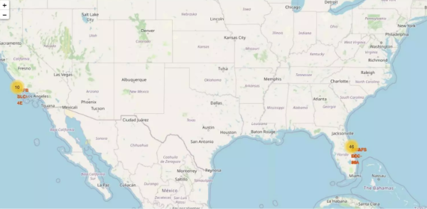
Build an Interactive Map with Folium
The launch success rate may depend on many factors such as payload mass, orbit type, and so on. It may also depend on the location and proximities of a launch site, i.e., the initial position of rocket trajectories. Finding an optimal location for building a launch site certainly involves many factors and hopefully we could discover some of the factors by analyzing the existing launch site locations.
https://github.com/yassin-asu/data-science-capstone-/blob/26caaf9ac9ad8d141cc6c34d3e4085601bce6101/folium%20launch%20site%20location.ipynb

Slide 14
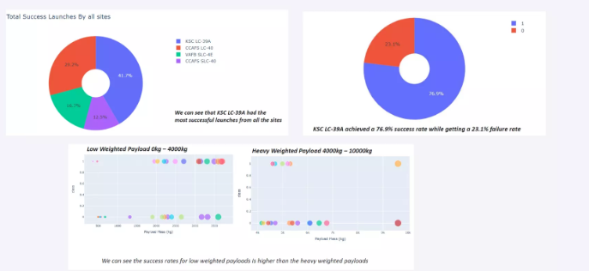
Build a Dashboard with Plotly Dash
Plots and graphs using Plotly dash for a more interactive experience
https://github.com/yassin-asu/data-science-capstone-/blob/26caaf9ac9ad8d141cc6c34d3e4085601bce6101/dashboard.ipynb

Slide 15
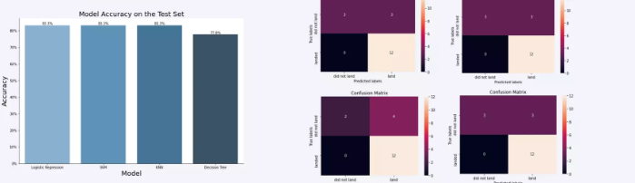
Predictive Analysis (Classification)
The SVM, KNN and Logistic Regression model achieved the highest accuracy at 83.3%, while the SVM performs the best in terms of Area Under the Curve at 0.958.
https://github.com/yassin-asu/data-science-capstone-/blob/26caaf9ac9ad8d141cc6c34d3e4085601bce6101/predicitive%20pipeline.ipynb

Slide 16
Results
• The SVM, KNN, and Logistic Regression models are the best in terms of prediction accuracy for this dataset.
• Low weighted payloads perform better than the heavier payloads.
• The success rates for SpaceX launches is directly proportional time in years they will eventually perfect the launches.
• KSC LC 39A had the most successful launches from all the sites.
• Orbit GEO,HEO,SSO,ES L1 has the best Success Rate.

Slide 17

Section 2

Slide 18
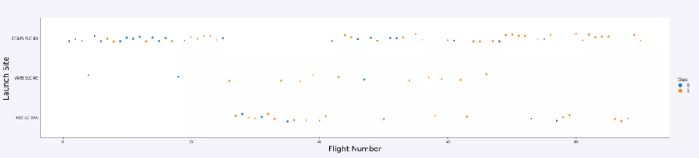
Flight Number vs. Launch Site
Show a scatter plot of Flight Number vs. Launch Site
Launches from the site of CCAFS SLC 40 ae significantly higher than launches from other sites

Slide 19
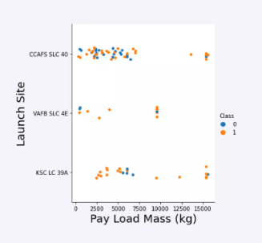
Payload vs. Launch Site
The majority of IPay loads with lower Mass have been launched from CCAFS SLC 40

Slide 20
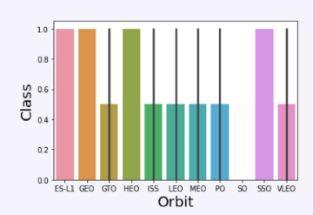
Success Rate vs. Orbit Type
The orbit of ES-L1,GEO, HEO, SSO are among the highest success rate

Slide 21
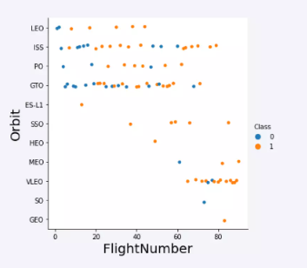
Flight Number vs. Orbit Type
A trend can be observed of shifting to VLEO launches in recent years.

Slide 22
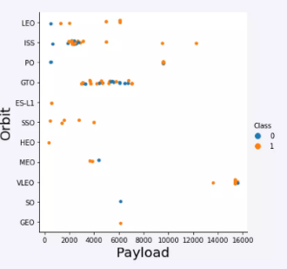
Payload vs. Orbit Type
There are strong correlation between ISS and payload at the range around 2000, as well as between GTO and the range of 4000-8000.

Slide 23
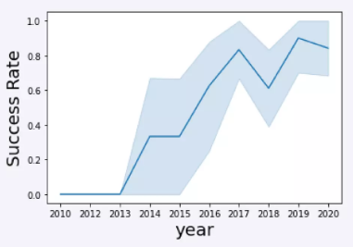
Launch Success Yearly Trend
Launch success rate increased significantly since 2013 and has stabilized since 2019, potentially due to advances in tech. and lessons learned.

Slide 24
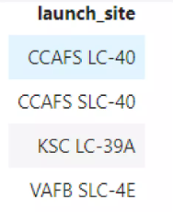
All Launch Site Names
%sql select distinct(LAUNCH_SITE) from SPACEXTBL

Slide 25
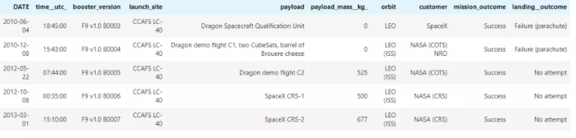
Launch Site Names Begin with 'CCA'
%sql select * from SPACEXTBL where LAUNCH_SITE like ‘CCA%’ limit 5

Slide 26
Total Payload Mass
%sql select sum(PAYLOAD_MASS__KG_) from SPACEXTBL where CUSTOMER = ‘NASA (CRS)’
Result is 45596

Slide 27
Average Payload Mass by F9 v1.1
%sql select avg(PAYLOAD_MASS__KG_) from SPACEXTBL where BOOSTER_VERSION = ‘F9 v1.1’
Result is 2928.4

Slide 28
First Successful Ground Landing Date
%sql select min(DATE) from SPACEXTBL where LANDING _OUTCOME = ‘Success (ground pad)’
Result is 2015-12-22

Slide 29
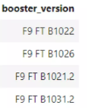
Successful Drone Ship Landing with Payload between 4000 and 6000
%sql select BOOSTER_VERSION from SPACEXTBL where Landing __OUTCOME =‘Success (drone ship)’ and PAYLOAD_MASS___KG_> 4000 and PAYLOAD_MASS__KG_< 6000

Slide 30
Total Number of Successful and Failure Mission Outcomes
%sql select count9MISSION_OUTCOME) from SPACEXTBL where MISSION_OUTCOME = ‘Success’ or MISSION_OUTCOME = ‘Failure (in flight)’
Result is 100

Slide 31
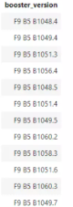
Boosters Carried Maximum Payload
%sql select BOOSTER_VERSION from SPACEXTBL where PAYLOAD_MASS__KG_ =(select mas(PAYLOAD_MASS__KG_) from SPACEXTBL)

Slide 32
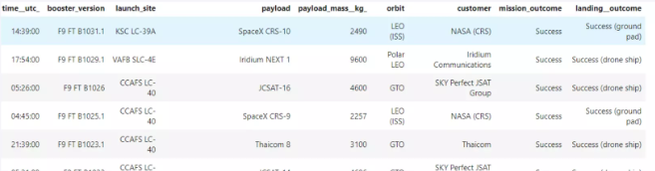
2015 Launch Records
%sql select * from SPACEXTBL where Landing__Outcome like ‘Success%’ and (DATE between ‘2015-01-01’ and ‘2015-12-31’) order by date desc
Present your query result with a short explanation here

Slide 33
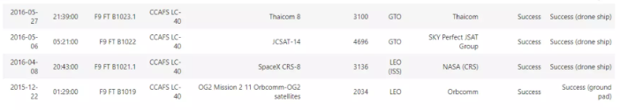
Rank Landing Outcomes Between 2010-06-04 and 2017-03-20
%sql select * from SPACEXTBL where Landing__Outcome like ‘Success%’ and (DATE between ‘2010-06-04’ and ‘2017-03-20’) order by date desc
Present your query result with a short explanation here

Slide 34

Section 3

Slide 35
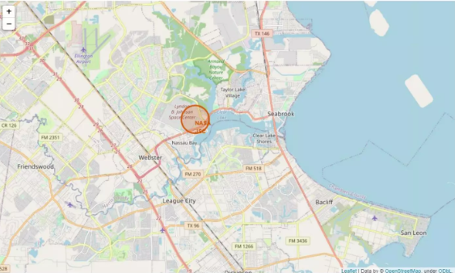
ALL launch sites marked on a map
Replace <Folium map screenshot 1> title with an appropriate title
Explore the generated folium map and make a proper screenshot to include all launch sites’ location markers on a global map
Explain the important elements and findings on the screenshot

Slide 36
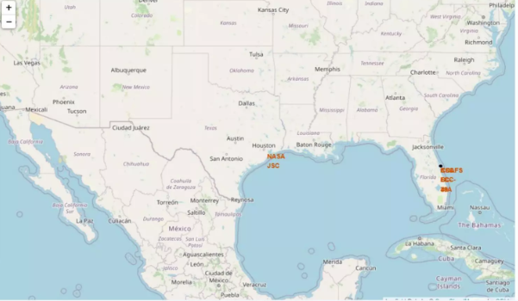
Success/failed launches marked on map
Replace <Folium map screenshot 2> title with an appropriate title
Explore the folium map and make a proper screenshot to show the color-labeled launch outcomes on the map
Explain the important elements and findings on the screenshot

Slide 37
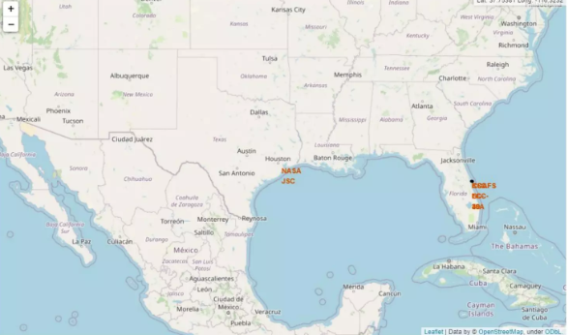
Distances between launch site to its proximities
Replace <Folium map screenshot 3> title with an appropriate title
Explore the generated folium map and show the screenshot of a selected launch site to its proximities such as railway, highway, coastline, with distance calculated and displayed
Explain the important elements and findings on the screenshot

Slide 38

Section 4

Slide 39
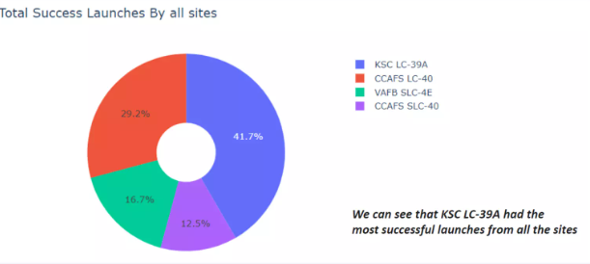
Total success launches by sites
Replace <Dashboard screenshot 1> title with an appropriate title
Show the screenshot of launch success count for all sites, in a piechart
Explain the important elements and findings on the screenshot

Slide 40
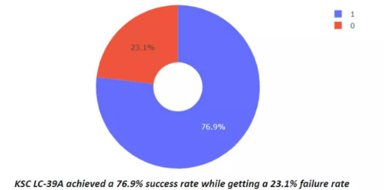
Success rate by site
Replace <Dashboard screenshot 2> title with an appropriate title
Show the screenshot of the piechart for the launch site with highest launch success ratio
Explain the important elements and findings on the screenshot

Slide 41
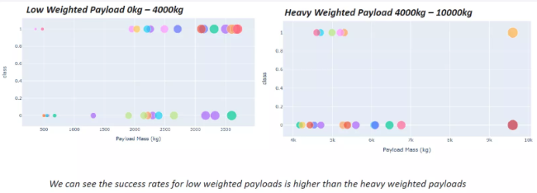
Payload vs launch outcome
Replace <Dashboard screenshot 3> title with an appropriate title
Show screenshots of Payload vs. Launch Outcome scatter plot for all sites, with different payload selected in the range slider
Explain the important elements and findings on the screenshot, such as which payload range or booster version have the largest success rate, etc.

Slide 42

Section 5

Slide 43
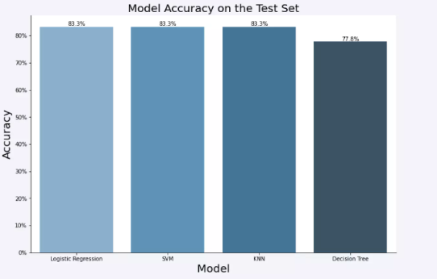
Classification Accuracy
Visualize the built model accuracy for all built classification models, in a bar chart
Find which model has the highest classification accuracy

Slide 44
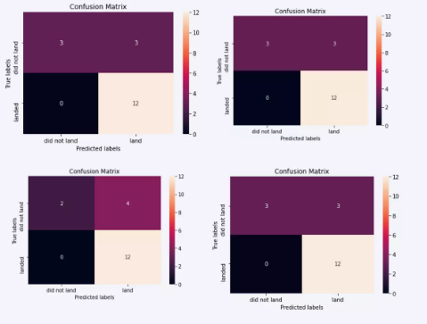
Confusion Matrix
Show the confusion matrix of the best performing model with an explanation

Slide 45
Conclusions
The SVM, KNN, and Logistic Regression models are the best in terms of prediction accuracy for this dataset.
Low weighted payloads perform better than the heavier payloads.
The success rates for SpaceX launches is directly proportional time in years they will eventually perfect the launches.
KSC LC 39A had the most successful launches from all the sites.
Orbit GEO,HEO,SSO,ES L1 has the best Success Rate.

Slide 46
Appendix
https://github.com/yassin-asu/data-science-capstone-.git

Slide 47


